Slide 1
Writing Simple Shell Scripts

Slide 2
shell 脚本
shell 脚本是一组命令、函数、变量或其他任何你可以在 shell 中使用的东西
你可以创建自己的 shell 脚本来自动执行你需要定期完成的任务。

Slide 3
greeting.sh
1
#!/bin/bash
2
#a Simple shell Script Example
3
#a Function
4
function say_hello()
5
{
6
echo "Enter Your Name,Please. :"
7
read name
8
echo "Hello $name"
9
}
10
echo "Programme Starts Here....."
11
say_hello
12
echo "Programme Ends."

Slide 4
创建脚本文件
创建 shell 脚本时，必须在脚本的第一行指定所使用的 shell。格式如下 格式如下 : #!/bin/bash
使用 chmod 命令赋予文件所有者执行文件的权限 $ chmod u+x filename.sh
执行shell脚本 bash filename.sh ./filename.sh

Slide 5
用户定义变量
变量名只能包含字母（a 至 z 或 A 至 Z）、数字（0 至 9）或下划线字符 (_)
shell 脚本中的变量名区分大小写
要访问存储在变量中的值，请在变量名前加上美元符号 ($) echo $NAME
大括号用于区分变量名和连接在一起的字符串。 echo ${city}abc
变量可以包含命令的输出 MYDATE=$(date) MACHINE=`uname -n` NUM_FILES=$(/bin/ls | wc -l)

Slide 6
引用
单引号：
用单引号（‘）括起字符，保留引号内每个字符的字面量
双引号：
双引号与单引号类似，但它允许 shell 解释美元符号 ($)、倒引号 (`)、反斜杠 (\) 和感叹号 (!)。
test=10
echo "$test"
echo ‘$test'
echo '$HOME * `date`'
echo ″$HOME * `date`“
echo $HOME * `date`

Slide 7
$ cat test3
#!/bin/bash
# testing variables
days=10
guest="Katie"
echo "$guest checked in $days days ago"
days=5
guest="Jessica"
echo "$guest checked in $days days ago"

Slide 8
特殊shell参数
位置参数或命令行参数$0, $1, $2, $3. .$n. $0 是特殊参数，它被指定为调用脚本时使用的名称；其他参数被指定为命令行参数的值，按它们出现的顺序排列。
$# 为脚本提供了多少个参数
$@ 变量保存在命令行中输入的所有参数接收最后执行的命令的退出状态
$?检查退出状态
Code Description
0 Successful completion of the command
1 General unknown error
2 Misuse of shell command
126 The command can’t execute
127 Command not found
128 Invalid exit argument
128+x Fatal error with Linux signal x
130 Command terminated with Ctrl+C
255 Exit status out of range

Slide 9
read命令
Reading in parameters
read [-p prompt] [name ...] [name2 ...]
#!/bin/bash
read -p "Type in an adjective, noun and verb (past tense): " adj1 noun1 verb1
echo "He sighed and $verb1 to the elixir. Then he ate the $adj1 $noun1."
如果 read 命令之后没有定义变量名，那么环境变量 REPLY 会包含所有的输入
read ; echo $REPLY

Slide 10
bash 中的参数扩展
${var:-value}: If variable is unset or empty, expand this to value.
$ THIS="Example"
$ THIS=${THIS:-"Not Set"}
$ THAT=${THAT:-"Not Set"}
$ echo $THIS
Example
$ echo $THAT
Not Set

Slide 11
模式匹配替换结构
${var#pattern}: Chop the shortest match for pattern from the front of var’s value.
${var##pattern}: Chop the longest match for pattern from the front of var’s value.
${var%pattern}: Chop the shortest match for pattern from the end of var’s value.
${var%%pattern}: Chop the longest match for pattern from the end of var’s value.
MYFILENAME=/home/digby/myfile.txt: Sets the value of MYFILENAME
FILE=${MYFILENAME##*/} : FILE becomes myfile.txt
DIR=${MYFILENAME%/*} : DIR becomes /home/digby
NAME=${FILE%.*} : NAME becomes myfile
EXTENSION=${FILE##*.} : EXTENSION becomes txt

Slide 12
在 shell 脚本中进行算术运算
Bash 使用无类型变量，这意味着它通常将变量视为文本字符串，但如果你需要，也可以更改它们
declare - 声明变量并赋予其属性。
可以使用内置的 let 命令或外部的 expr 或 bc 命令进行整数运算。
BIGNUM=1024
let RESULT=$BIGNUM/16
RESULT=`expr $BIGNUM / 16`
RESULT=`echo "$BIGNUM / 16" | bc`
let foo=$RANDOM; echo $foo
expr
运算符之间要有空格，例如：expr<空格>变量<空格>运算符
乘法运算符使用 \*
$ cat test9
#!/bin/bash
var1=$(echo "scale=4; 3.44 / 5" | bc)
echo The answer is $var1

Slide 13
$[ 算术表达式 ] echo $[5+9] echo $[$a/2]
$((算术表达式)) echo $((5+9)) echo $(($a/2))

Slide 14
Using programming constructs in shell scripts
The ″if. . .then″ statements
if command
then <commands> fi
$ cat test1.sh
#!/bin/bash
# testing the if statement
if pwd
then
echo "It worked"
fi
if command; then
commands
fi
$ ./test1.sh

Slide 15
$ cat test3.sh
#!/bin/bash
# testing multiple commands in the then section
#
testuser=Christine
#
if grep $testuser /etc/passwd
then
echo "This is my first command"
echo "This is my second command"
echo "I can even put in other commands besides echo:"
ls -a /home/$testuser/.b*
fi

Slide 16
The ″if. . .then…else″ statements
$ cat test4.sh
#!/bin/bash
# testing the else section
#
testuser=NoSuchUser
#
if grep $testuser /etc/passwd
then
echo "The bash files for user $testuser are:"
ls -a /home/$testuser/.b*
echo
else
echo "The user $testuser does not exist on this system."
echo
fi
if command
then <commands> else <other commands> fi

Slide 17
#!/bin/bash
#another example script of if
echo "Input a directory,please!"
read dir_name
if cd $dir_name > /dev/null 2>&1 ;then
echo "enter directory:$dir_name succeed"
else
echo "enter directory:$dir_name failded"
fi

Slide 18
if command
then <commands> elif commands then <different commands> else <other commands> fi
if command1
then
command set 1
elif command2
then
command set 2
elif command3
then
command set 3
elif command4
then
command set 4
fi

Slide 19
$ cat test5.sh
#!/bin/bash
# Testing nested ifs - use elif & else
#
testuser=NoSuchUser
#
if grep $testuser /etc/passwd
then
echo "The user $testuser exists on this system."
#
elif ls -d /home/$testuser
then
echo "The user $testuser does not exist on this system."
echo "However, $testuser has a directory."
#
else
echo "The user $testuser does not exist on this system."
echo "And, $testuser does not have a directory."
fi

Slide 20
test Command
test命令提供了一种在 if-then 语句中测试不同条件的方法
如果测试命令中列出的条件评估结果为 "true"，测试命令将以 0 的退出状态代码退出
测试命令的格式非常简单：
test 条件
条件是一系列参数和值，测试命令将对这些参数和值进行评估.

Slide 21
if test condition
then
commands
fi
bash shell 提供了另一种测试条件的方法，无需在 if-then 语句中声明test命令：
if [ condition ]
then
commands
fi
注意：第一个括号后必须有一个空格，最后一个括号前必须有一个空格。否则会出现错误信息。

Slide 22
The test command and test conditions can evaluate three classes of conditions:
数字比较
字符串比较
文件比较

Slide 23
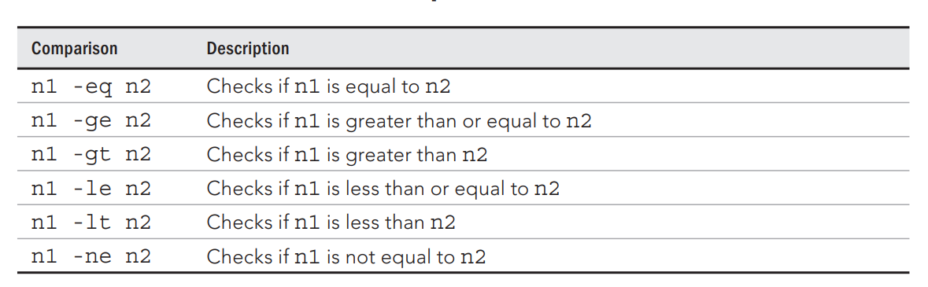
数字比较
value1=10
value2=11
if [ $value1 -gt 5 ]
then
echo "The test value $value1 is greater than 5"
fi
if [ $value1 -eq $value2 ]
then
echo "The values are equal"
else
echo "The values are different"
fi

Slide 24
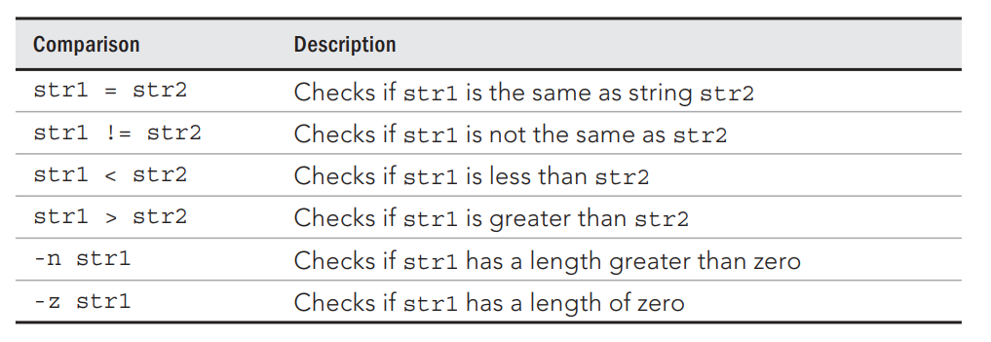
字符串比较
#!/bin/bash
# testing string equality
testuser=rich
#
if [ $USER = $testuser ]
then
echo "Welcome $testuser"
fi

Slide 25
#!/bin/bash
# mis-using string comparisons
#
val1=baseball
val2=hockey
#
if [ $val1 \> $val2 ]
then
echo "$val1 is greater than $val2"
else
echo "$val1 is less than $val2"
fi
$ cat badtest.sh
#!/bin/bash
# mis-using string comparisons
#
val1=baseball
val2=hockey
#
if [ $val1 > $val2 ]
then
echo "$val1 is greater than $val2"
else
echo "$val1 is less than $val2"
fi

Slide 26
文件比较
Comparison Description
-d file Checks if file exists and is a directory
-e file Checks if file exists
-f file Checks if file exists and is a file
-r file Checks if file exists and is readable
-s file Checks if file exists and is not empty
-w file Checks if file exists and is writable
-x file Checks if file exists and is executable
-O file Checks if file exists and is owned by the current user

Slide 27
#!/bin/bash
# Look before you leap
#
jump_directory=/home/arthur
#
if [ -d $jump_directory ]
then
echo "The $jump_directory directory exists"
cd $jump_directory
ls
else
echo "The $jump_directory directory does not exist"
fi

Slide 28
#!/bin/bash
location=$HOME
file_name="sentinel"
#
if [ -e $location ]
then #Directory does exist
echo "OK on the $location directory."
echo "Now checking on the file, $file_name."
#
if [ -e $location/$file_name ]
then #File does exist
echo "OK on the filename"
echo "Updating Current Date..."
date >> $location/$file_name
#
else #File does not exist
echo "File does not exist"
echo "Nothing to update"
fi
#
else #Directory does not exist
echo "The $location directory does not exist."
echo "Nothing to update"
fi

Slide 29
Combining Expressions
■ [ condition1 ] && [ condition2 ]
■ [ condition1 ] || [ condition2 ]
#!/bin/bash
# testing compound comparisons
#
if [ -d $HOME ] && [ -w $HOME/testing ]
then
echo "The file exists and you can write to it"
else
echo "I cannot write to the file"
fi

Slide 30
# [ test ] || action
# Perform simple single command if test is false
dirname="/tmp/testdir"
[ -d "$dirname" ] || mkdir "$dirname"
# [ test ] && {action}
# Perform simple single action if test is true
[ $# -ge 3 ] && echo "There are at least 3 command line arguments."
# dirname=mydirectory
[ -e $dirname ] && echo $dirname already exists || mkdir $dirname

Slide 31
#!/bin/bash
myhost=centos1.ls-al.me
if ping -c1 -w2 $myhost &>/dev/null
then
echo "$myhost is UP."
else
echo "$myhost is DOWN."
fi

Slide 32
#!/bin/bash
## filename: decide_file_type.sh
[ $# -ne 1 ] && echo "Usage: $0 <filename>" ; exit 1
file=$1
if [ -d $file ]
then echo "$file is a directory"
elif [ -f $file ]
then
if [ -r $file -a -w $file -a -x $file ] ; then
# if [[ -r $file && -w $file && -x $file ]] ; then
echo “You have (rwx) permissioon on $file."
fi
else
echo "$file is neither a file nor a directory."
fi

Slide 33
Working with Advanced if-then Features
Double parentheses for mathematical expressions
Double square brackets for advanced string handling functions
#!/bin/bash
# using double parenthesis
#
val1=10
#
if (( $val1 ** 2 > 90 ))
then
(( val2 = $val1 ** 2 ))
echo "The square of $val1 is $val2"
fi
#!/bin/bash
# using pattern matching
#
if [[ $USER == r* ]]
then
echo "Hello $USER"
else
echo "Sorry, I do not know you"
fi

Slide 34
The case command
case expr in # expr 为表达式，关键词 in 不要忘！
pattern1) # 若 expr 与 pattern1 匹配，注意括号
commands1 # 执行语句块 commands1
;; # 跳出 case 结构
pattern2) # 若 expr 与 pattern2 匹配
commands2 # 执行语句块 commands2
;; # 跳出 case 结构 ... ... # 可以有任意多个模式匹配
*) # 若 expr 与上面的模式都不匹配
commands # 执行语句块 commands
;; # 跳出 case 结构 esac # case 语句必须以 esac 终止

Slide 35
case variable in
pattern1 | pattern2) commands1;;
pattern3) commands2;;
*) default commands;;
esac
#!/bin/bash
# using the case command
#
case $USER in
rich | barbara)
echo "Welcome, $USER"
echo "Please enjoy your visit";;
testing)
echo "Special testing account";;
jessica)
echo "Do not forget to log off when you're done";;
*)
echo "Sorry, you are not allowed here";;
esac

Slide 36
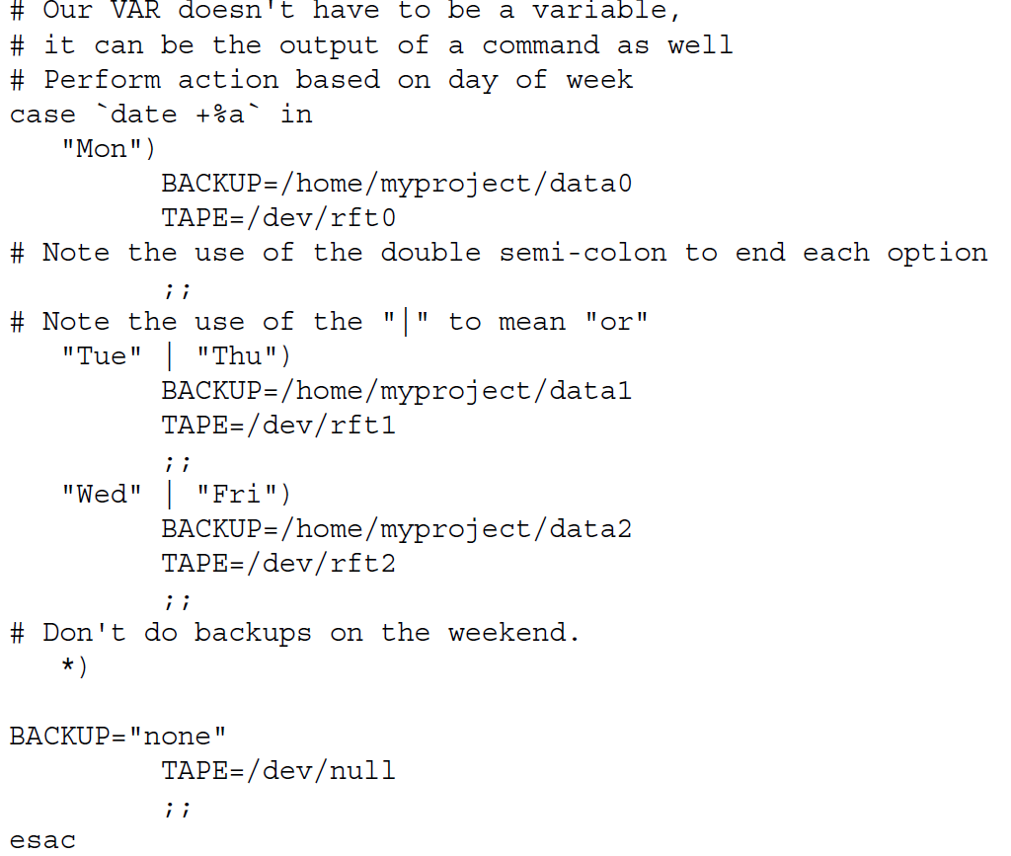

Slide 37
The ″for. . .do″ loop
for variable in list
# 每一次循环，依次把列表 list 中的一个值赋给循环变量
do # 循环体开始的标志
commands # 循环变量每取一次值，循环体就执行一遍
done # 循环结束的标志，返回循环顶部
The list is normally:
Strings
Numbers
Command line arguments
File names
Linux command output

Slide 38
for NAME in John Paul Ringo George ; do
echo $NAME is my favorite Beatle
done
for NUMBER in 0 1 2 3 4 5 6 7 8 9
do
echo The number is $NUMBER
done
for number in {1..10}
for number in {0..100..10}
for fn in /etc/[abcd]*.conf ; do
echo $fn
done
for FILE in `/bin/ls`
do
echo $FILE
done

Slide 39
#!/bin/bash
## filename: addusers_foreach.sh
for x in {1..50}
do
useradd user${x}
echo "centos"|passwd --stdin user${x}
chage -d 0 user${x}
done

Slide 40
Changing the field separator
Internal field separator.
The IFS environment variable defines a list of characters the bash shell uses as field separators.
By default, the bash shell considers the following characters as field separators:
A space
A tab
A newline

Slide 41
#!/bin/bash
# reading values from a file
file=“cities"
IFS=$'\n'
for city in $(cat $file)
do
echo "Visit beautiful $city"
done
IFS=$'\n':;"
IFS.OLD=$IFS
IFS=$'\n'
<use the new IFS value in code>
IFS=$IFS.OLD

Slide 42
C syntax
LIMIT=10
# Double parentheses, and no $ on LIMIT even though it's a variable!
for ((a=1; a <= LIMIT ; a++)) ; do
echo "$a"
done

Slide 43
The ″while. . .do″ and ″until. . .do″ loops
while expr # 执行 expr
do # 若expr的退出状态为0，进入循环，否则退出while
commands # 循环体
done # 循环结束标志，返回循环顶部
until expr # 执行 expr
do # 若expr的退出状态非0，进入循环，否则退出until
commands # 循环体
done # 循环结束标志，返回循环顶部

Slide 44
var1=10
while [ $var1 -gt 0 ]
do
echo $var1
var1=$[ $var1 - 1 ]
done
var1=100
until [ $var1 -eq 0 ]
do
echo $var1
var1=$[ $var1 - 25 ]
done

Slide 45
Looping on File Data
■ Using nested loops
■ Changing the IFS environment variable

Slide 46
Nesting Loops
#!/bin/bash
# changing the IFS value
IFS.OLD=$IFS
IFS=$'\n'
for entry in $(cat /etc/passwd)
do
echo "Values in $entry –"
IFS=:
for value in $entry
do
echo " $value"
done
done

Slide 47
Controlling the Loop
The break command
The continue command

Slide 48
#!/bin/bash
# breaking out of an outer loop
for (( a = 1; a < 4; a++ ))
do
echo "Outer loop: $a"
for (( b = 1; b < 100; b++ ))
do
if [ $b -gt 4 ]
then
break 2
fi
echo " Inner loop: $b"
done
done
for var1 in 1 2 3 4 5 6 7 8 9 10
do
if [ $var1 -eq 5 ]
then
break
fi
echo "Iteration number: $var1"
done

Slide 49
#!/bin/bash
# continuing an outer loop
for (( a = 1; a <= 5; a++ ))
do
echo "Iteration $a:"
for (( b = 1; b < 3; b++ ))
do
if [ $a -gt 2 ] && [ $a -lt 4 ]
then
continue 2
fi
var3=$[ $a * $b ]
echo " The result of $a * $b is $var3"
done
done
#!/bin/bash
# using the continue command
for (( var1 = 1; var1 < 15; var1++ ))
do
if [ $var1 -gt 5 ] && [ $var1 -lt 10 ]
then
continue
fi
echo "Iteration number: $var1"
done

Slide 50
Processing the Output of a Loop
for file in /home/rich/*
do
if [ -d "$file" ]
then
echo "$file is a directory"
elif
echo "$file is a file"
fi
done > output.txt
#!/bin/bash
# piping a loop to another command
for state in "North Dakota" Connecticut Illinois Alabama Tennessee
do
echo "$state is the next place to go"
done | sort

Slide 51
#!/bin/bash
# finding files in the PATH
IFS=:
for folder in $PATH
do
echo "$folder:"
for file in $folder/*
do
if [ -x $file ]
then
echo " $file"
fi
done
done
#!/bin/bash
# process new user accounts
input="users.csv"
while IFS=',' read -r userid name
do
echo "adding $userid"
useradd -c "$name" -m $userid
done < "$input"

Slide 52
Handling User Input
Passing parameters
Tracking parameters
Being shifty
Working with options
Standardizing options
Getting user input

Slide 53
Passing Parameters
#!/bin/bash
# ScriptName: vartest.sh
# To test Positional Parameters & Special Parameters.
echo "Hello,$USER,the output of this script are as follows:"
echo "The script name is : $(basename $0)"
echo "The first param of the script is : $1"
echo "The second param of the script is : $2"
echo "The tenth param of the script is : ${10}"
echo "All the params you input are : $@"
echo "All the params you input are : $*"
echo "The number of the params you input are: $#"
echo "The process ID for this script is : $$"
echo "The exit status of this script is : $?”
$ ./vartest.sh 1 ‘2 3’ 4 5 a b c d e f g

Slide 54
测试参数
$ cat test6.sh
#!/bin/bash
# Testing a Multi-function script
#
name=$(basename $0)
#
if [ $name = "addem" ]
then
total=$[ $1 + $2 ]
#
elif [ $name = "multem" ]
then
total=$[ $1 * $2 ]
fi
#
echo
echo The calculated value is $total
cp test6.sh addem
chmod u+x addem
ln -s test6.sh multem
./addem 2 5
./multem 2 5

Slide 55
特殊参数变量
$ cat test9.sh
#!/bin/bash
# Testing parameters
#
if [ $# -ne 2 ]
then
echo
echo Usage: test9.sh a b
echo
else
total=$[ $1 + $2 ]
echo
echo The total is $total
echo
fi
#

Slide 56
$@和@*传递给脚本或函数的所有参数当被双引号“”包含时，$@和@*稍有不同，$*把所有的参数看做一个整体，而$@把每个参数区分对待
## $@ expands to the positional parameters, starting from one. ##
for i in $@
do
echo "Script arg is $i"
done
#!/bin/sh
for nvar in $*
do
echo "Parameter contains: $nvar"
done
for var in "$*"
do
echo $var
done

Slide 57
Shift
while [ -n "$1" ]
do
echo "Parameters(\$$count) is:$1"
let count=$count+1
shift
done

Slide 58
Working with Options(*)
Finding your options
Using the getopt command
getopts

Slide 59
基本的读取
#!/bin/bash
# testing the read -p option
#
read -p "Please enter your age: " age
days=$[ $age * 365 ]
echo "That makes you over $days days old! "
$ cat test25.sh
#!/bin/bash
# timing the data entry
#
if read -t 5 -p "Please enter your name: " name
then
echo "Hello $name, welcome to my script"
else
echo
echo "Sorry, too slow! "
fi

Slide 60
从文件中读取
#!/bin/bash
# reading data from a file
#
count=1
cat test | while read line
do
echo "Line $count: $line"
count=$[ $count + 1]
done
echo "Finished processing the file"
while IFS= read -r line
do
command1 on $line
command2 on $line
..
....
commandN
done < "/path/to/filename"
IFS is used to set field separator (default is while space). The -r option to read command disables backslash escaping (e.g., \n, \t).

Slide 61
#!/bin/bash
## filename: while--read_file.sh
file=/etc/resolv.conf
while IFS= read -r line
do
# echo line is stored in $line
echo $line
done < "$file"
while IFS=: read -r user enpass uid gid desc home shell
do
# only display if UID >= 500
[ $uid -ge 500 ] && echo "User $user ($uid) assigned \"$home\" home directory with $shell shell."
done < /etc/passwd

Slide 62
#!/bin/bash
## filename: while-rename_filename.sh
DIR="."
find $DIR -type f | while read file; do
# using POSIX class [:space:] to find space in the filename
if [[ "$file" = *[[:space:]]* ]]; then
# substitute space with "_" character (rename the filename)
mv "$file" $(echo $file | tr ' ' '_')
fi
done
# 找出当前目录下包含空格的文件名，将空格替换为下划线

Slide 63
#!/bin/bash
## filename: until-host_online_to_ssh.sh
read -p "Enter IP Address:" ipadd
echo $ipadd
until ping -c 1 $ipadd &> /dev/null
do
sleep 60
done
ssh $ipadd

Slide 64
#!/bin/bash
## filename: until-user_online_to_write.sh
username=$1
if [ $# -lt 1 ] ; then
echo "Usage: `basename $0` <username> [<message>]"
exit 1
fi
if grep "^$username:" /etc/passwd > /dev/null ; then :
else
echo "$username is not a user on this system."
exit 2
fi
until who|grep "$username" > /dev/null ; do
echo "$username is not logged on."
sleep 600
done
shift ; msg=$*
[[ X"$msg" == "X" ]] && msg="Hello, $username"
echo "$msg" | write $username

Slide 65
Shell Functions
shell functions are“mini-scripts” that are located inside other scripts
Shell functions have two syntactic forms. First, the more formal form:
function name {
commands
return
}
name () {
commands
return
}

Slide 66
#!/bin/bash
function fun1(){
}
......
funciton funn(){
}
...........
.
.
.
.
1 #!/bin/bash
2
3 # Shell function demo
4
5 function step2 {
6 echo "Step 2"
7 return
8 }
9
10 # Main program starts here
11
12 echo "Step 1“
13 step2
14 echo "Step 3"

Slide 67
#!/bin/bash
## filename: pp_and_function.sh
echo "===Print positional parameters in main :"
echo "$0: $*"
pp1(){
echo 'f1--Print $* parameters in fun1 :' ; echo "$0: $*"
}
pp2(){
echo 'f2--Print $* parameters in fun1 :' ; echo "$0: $*"
pp1 1st 2nd 3th 4th 5th 6th 7th 8th 9th
echo 'f2--Print $* parameters in fun1 :' ; echo "$0: $*"
}
pp1 1 2 3 4 5 6 7 8 9
echo "===Print positional parameters in main :"
echo "$0: $*"
pp2 I II III IV V VI VII VIII IX
./pp_and_function.sh a b c d e f g h i

Slide 68
#!/bin/bash
# (@)/ph
# A very simple telephone list
# Type "ph new name number" to add to the list, or
# just type "ph name" to get a phone number
PHONELIST=~/.phonelist.txt
# If no command line parameters ($#), there
# is a problem, so ask what they're talking about.
if [ $# -lt 1 ] ; then
echo "Whose phone number did you want? "
exit 1
fi
# Did you want to add a new phone number?
if [ $1 = "new" ] ; then
shift echo $* >> $PHONELIST
echo $* added to database
exit 0
fi
# Nope. But does the file have anything in it yet?
# This might be our first time using it, after all.
if [ ! -s $PHONELIST ] ; then
echo "No names in the phone list yet! "
exit 1
else
grep -i -q "$*" $PHONELIST # Quietly search the file
if [ $? -ne 0 ] ; then # Did we find anything?
echo "Sorry, that name was not found in the phone list"
exit 1
else
grep -i "$*" $PHONELIST
fi
fi
exit 0

Slide 69
#!/bin/bash
# (@)/my_backup
# A very simple backup script
#
# Change the TAPE device to match your system.
# Check /var/log/messages to determine your tape device.
# You may also need to add scsi-tape support to your kernel.
TAPE=/dev/rft0
# Rewind the tape device $TAPE
mt $TAPE rew
# Get a list of home directories
HOMES=`grep /home /etc/passwd | cut -f6 -d':'`
# Back up the data in those directories
tar cvf $TAPE $HOMES
# Rewind and eject the tape.
mt $TAPE rewoffl

